Slide 1
Rivers and Streams
By C. D. Boch

Slide 2
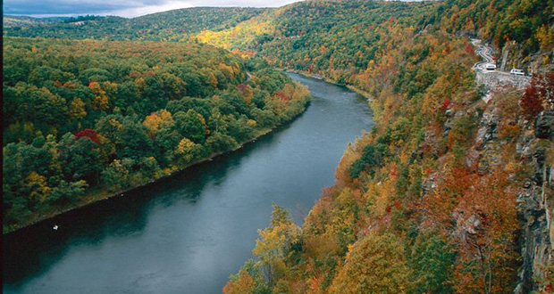

Slide 3
Channel Flow vs. Sheet Flow
Erosion - is the action of surface processes (such as water flow or wind) that removes soil, rock, or dissolved material from one location on the Earth's crust, and then transports it to another location.
Channel Flow - is when water from rain and snow runs downhill and erodes a path into existing rock and sediment. It almost always flows into a large body of water.
Sheet Flow – occurs mostly in arid regions with little or no vegetation. Water flows across a wide surface rapidly but infrequently.

Slide 4
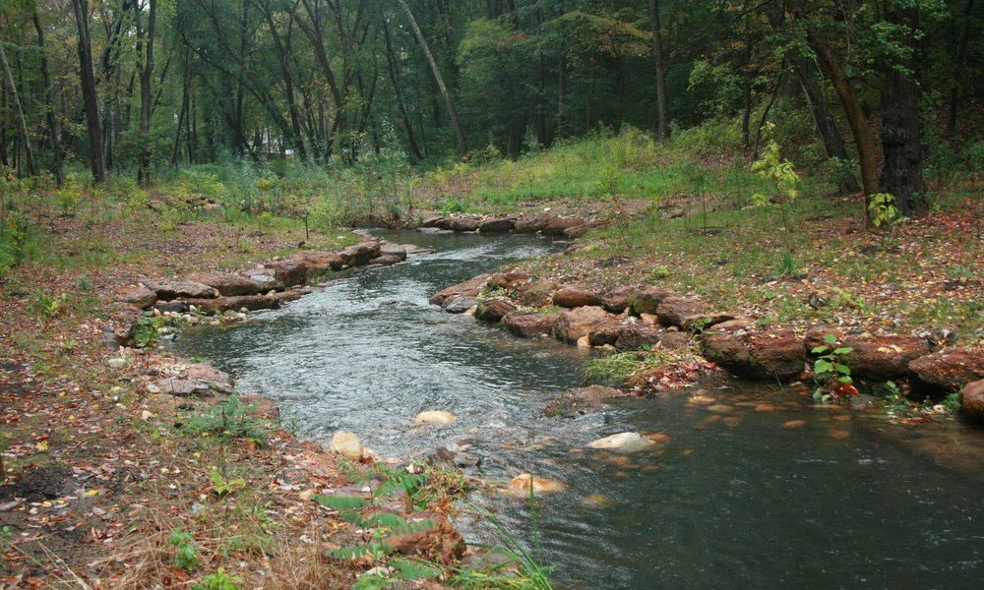
River or Stream?
There is no real rule. River, Stream, Creek, Brook, Run there are no rules as to naming. And, the rules that govern how they behave, apply to all, no matter where, or what size.

Slide 5
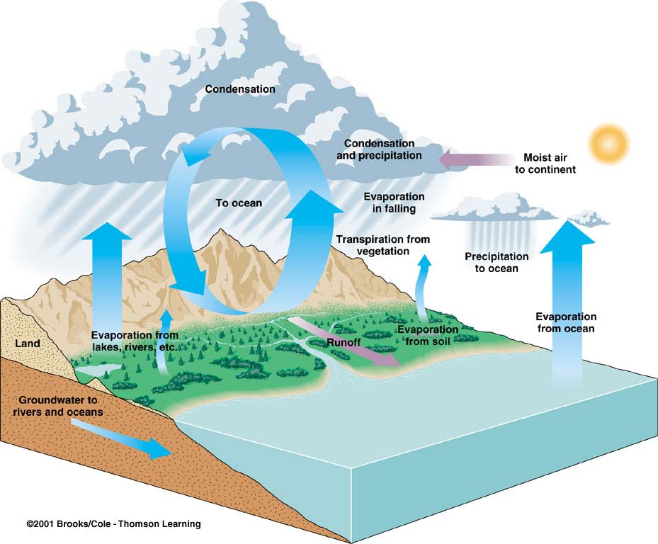
The Hydrologic Cycle
The hydrologic cycle consists of reservoirs where water is stored and pathways along which water moves at or near Earth’s surface.
Reservoirs include: oceans, rivers and streams, lakes, atmo- sphere, glaciers, and groundwater.
Pathways include: evaporation, transpiration, precipitation, surface runoff, and groundwater flow.

Slide 6
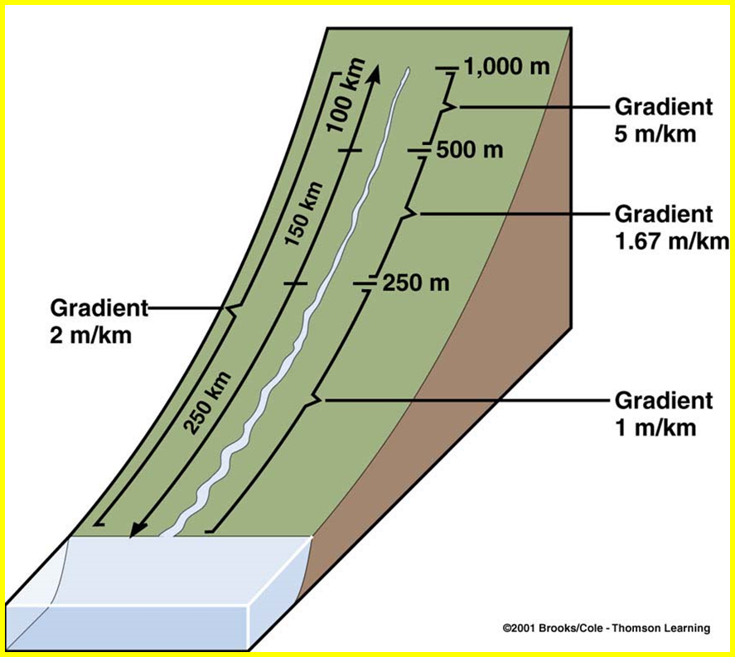
Water in a channel flows downhill over a slope known as the gradient. Gradient is the vertical drop divided by the horizontal distance along the stream. (Rise over Run)
Gradient is not uniform over the full course of a stream. Rather, it varies from steeper in the headwater area to low gradient in downstream reaches

Slide 7
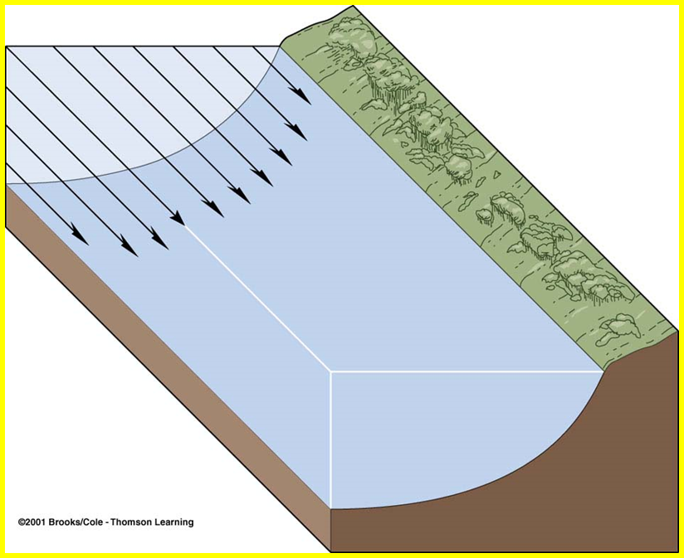
Gradient, Velocity, and Discharge
Stream velocity measures the distance water travels in a given time. Velocity varies across a channel. Flow is slowest along the sides and bottom of the channel where flow is impeded by turbulence.
Velocity is generally greatest near the middle of the stream, just below the surface. Velocity is commonly measured in ft/sec or m/sec.

Slide 8
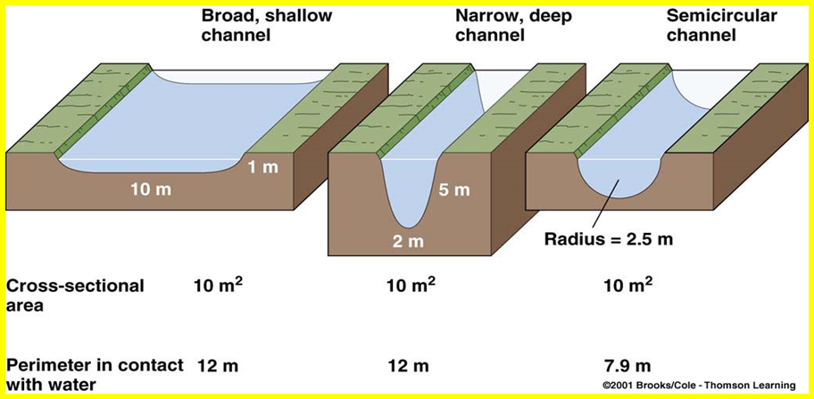
Gradient, Velocity, and Discharge
Channel shape and roughness influence flow velocity. All other things equal, semi-circular channels permit higher velocity because less water is in contact with channel margins where friction acts to impede flow.
Average flow velocity increases downstream.

Slide 9
Gradient, Velocity, and Discharge
Stream discharge is the volume of water passing a particular point in a given period of time. Discharge is measured in ft³/sec or m³/sec. Discharge can be calculated using the following formula:
(Q) discharge = (V) velocity x (A) cross-sectional area of channel
The Cuyahoga River discharges about 30 cubic meters per second.
The Mississippi River discharges about 18,000 cubic meters of water every second.
The Amazon River discharges 200,000 cubic meters every second.

Slide 10
Eroded Sediment
Once eroded, sediment transported in running water can be divided into three components or loads.
The dissolved load is invisible and consists of ions taken into solution during chemical weathering.
The suspended load consists of mud kept in suspension above the channel bed by turbulence. Streams with large suspended loads have a murky look.
The bed load consists of sand and gravel too large for turbulence to suspend. The coarser bed load sediment moves by sliding or rolling along the channel bottom. The sand moves by intermittent bouncing or skipping known as saltation.

Slide 11
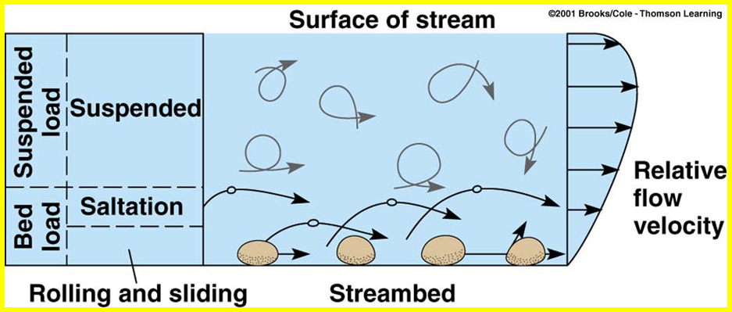

Slide 12
Deposition and Stream Types
Sediment deposited by running water is called alluvium.
Most of the geologic work (erosion, transport, and deposition) done by running water takes place during periodic flooding.
Braided streams possess multiple channels that divide and rejoin they are found mostly in deserts where there is little of no vegetation.
Meandering streams have single, winding channels that form broad looping curves known as meanders. Oxbow lakes are common along meandering streams. They form when individual meanders are abandoned by the stream.

Slide 13
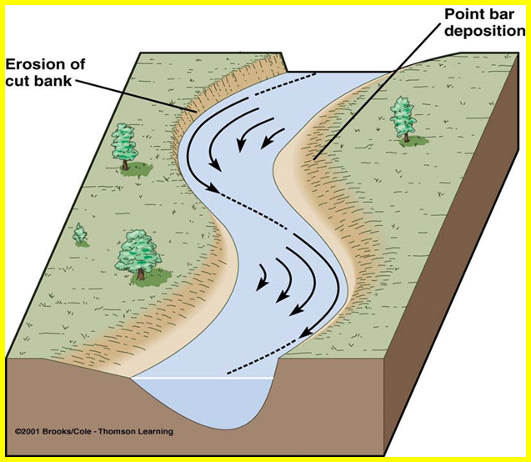
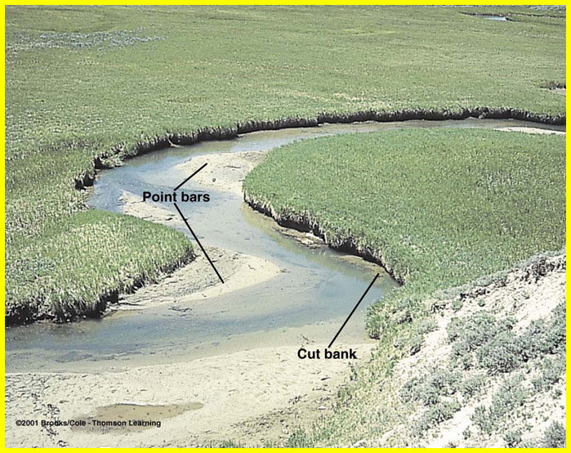
The Deposits of Meandering Channels
In meanders, the channel cross-section is asymmetric. The channel bank on the outside of the bend or meander is steeper than on the inside of the bend. The bank on the outside is actively eroding and known as the cut bank. Flow velocity is lower along the inside of the meander so along this bank, sediment is deposited to form a point bar.

Slide 14
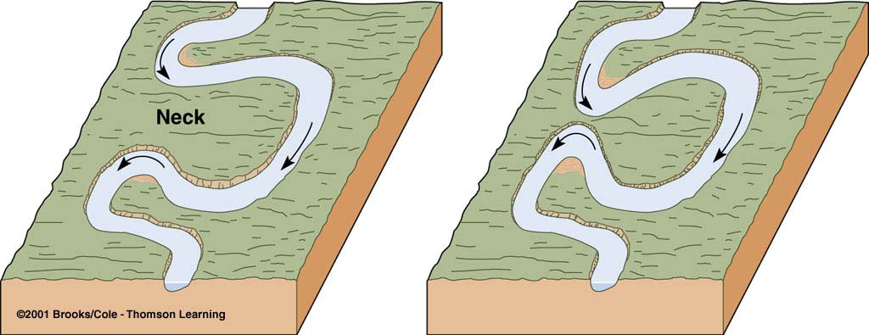
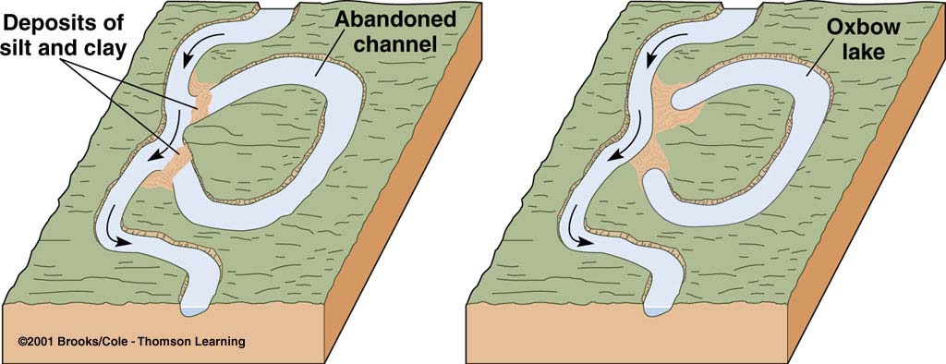
The Deposits of Meandering Channels
Meanders sometimes become so sinuous that the neck of land between them can be eroded away during flooding (A). As a result, the flow will follow a new, straighter course, and the meander will be cut-off or abandoned by the stream (B). The abandoned meanders are referred to as oxbow lakes. Oxbow lakes may persist for some time, but are eventually filled with organic matter and mud carried in during flooding of the active stream.

Slide 15
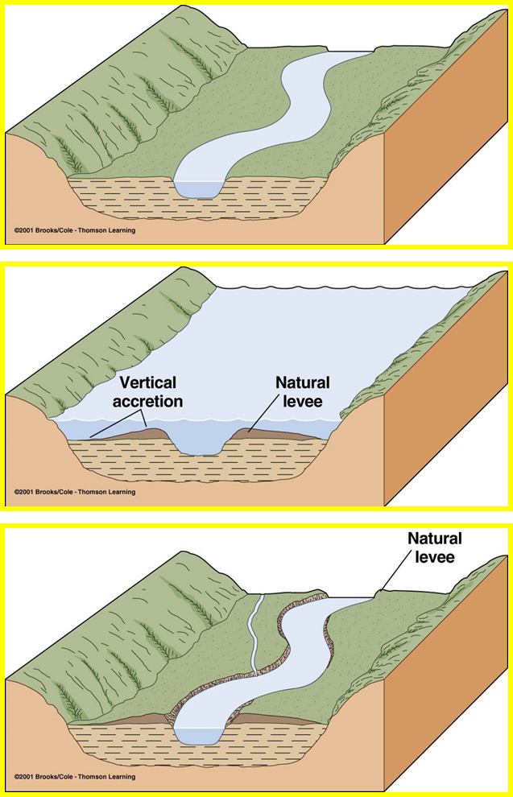
Floodplains
Floodplains are low-lying, flat areas adjacent to channels (A).
When streams overtop their banks, water carrying mud and fine-grained sand spreads across the floodplain (B).
As flood water flows from the channel, its velocity and depth rapidly decrease. As a result, the coarser floodplain sediment, fine-grained sand, is deposited along the channel margin to form a ridge, a natural levee (C).
A
B
C

Slide 16
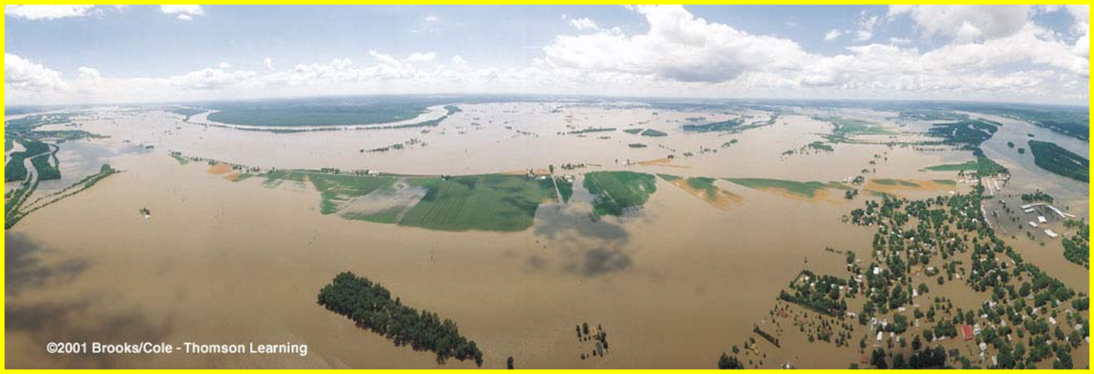
Mississippi River, 1993

Slide 17
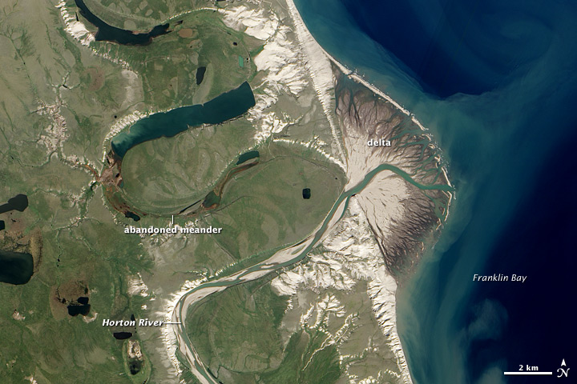
Deltas
A delta forms where a river discharges into a standing body of water, a lake or the sea. Sediment accumulates such that the shoreline gradually builds outward.

Slide 18
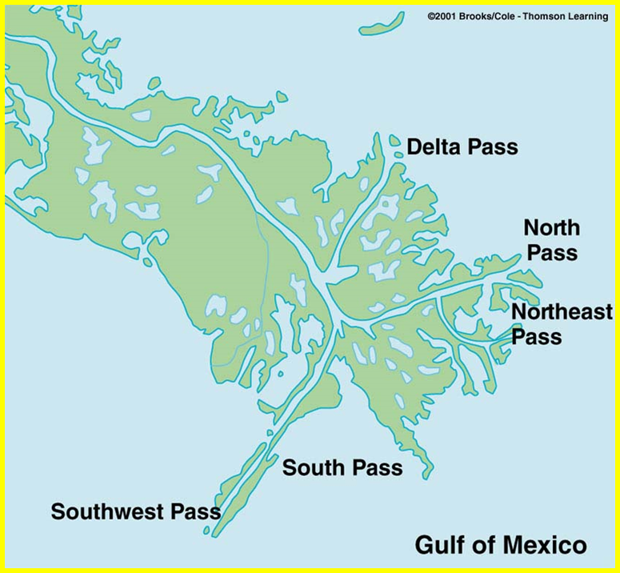
Deltas
Deltas forming along sea coasts are often large, complex, and sometimes economically important.
The Mississippi delta is a bird’s-foot delta, the classic shape of river-dominated deltas.
Much of the oil and gas produced in the Gulf of Mexico comes from buried delta deposits.
The swampy areas typical of most deltas are potential areas of coal formation.

Slide 19
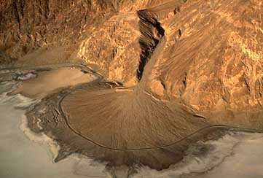
Alluvial Fans
Alluvial fans are lobate deposits formed along the boundary between lowlands and mountains. They form in arid and semiarid areas. They resemble deltas.

Slide 20
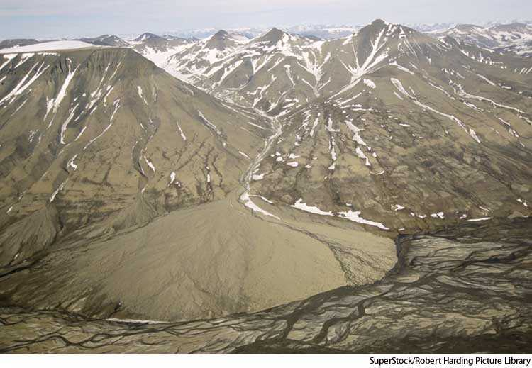

Slide 21
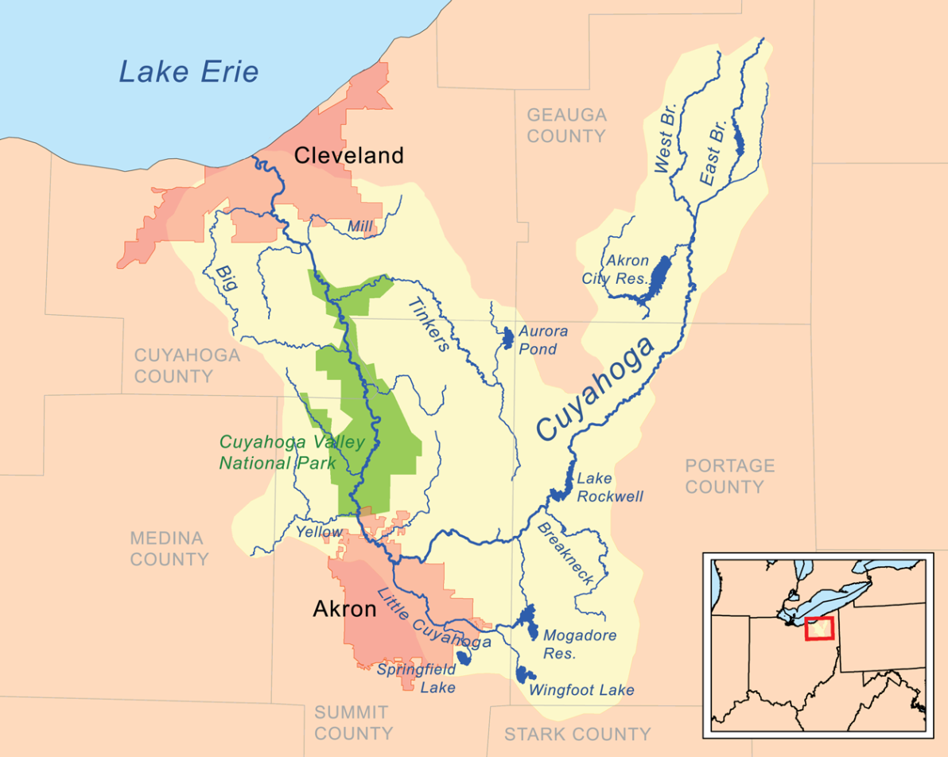
Watersheds
The Watershed, or Drainage Basin is the area that drains into a specific bod of water.
At the right is the map of the Cuyahoga river Watershed.

Slide 22
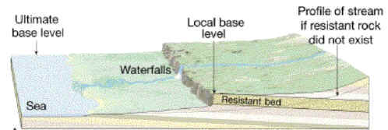
Base Level
Base level is the lowest level to which a stream can erode.
Sea level is the ultimate base level.

Slide 23
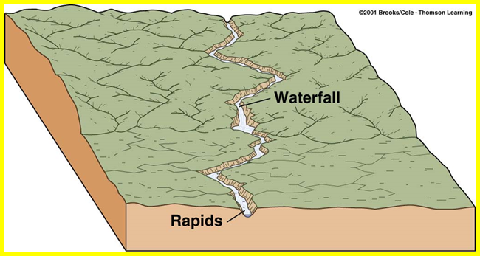
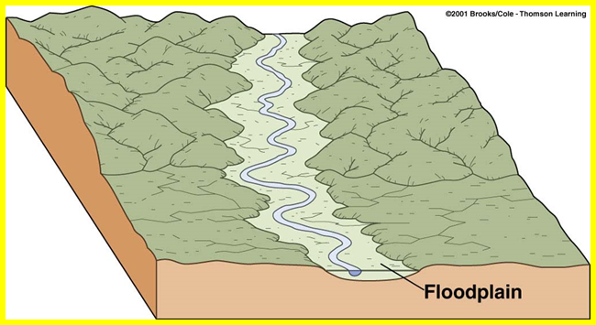
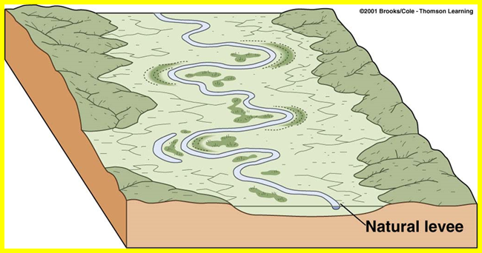
Evolution of Valleys

Slide 24
Floods And Flood Control
Attempts at Flood prevention include…
Artificial Levees – good for small seasonal floods, can make major floods worse
Flood control dams – Once mandatory, today no longer preferred
Water diversion – rerouting flood water to an alternate path
Use of wetlands to absorb flood water is now considered the best way to control flooding

